Slide 1

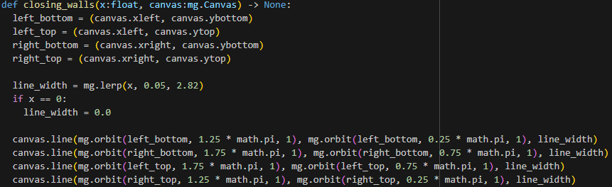

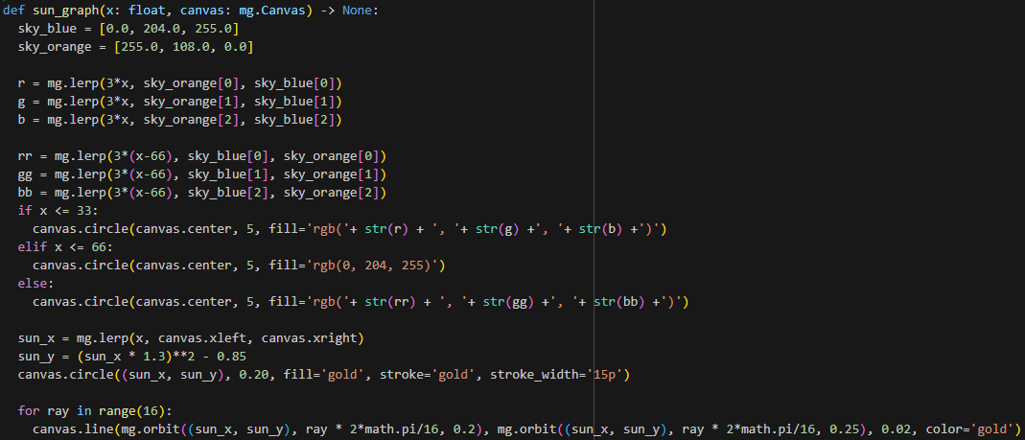
Notes:
I decided to create two separate graphs to test out different approaches to the design.
First design is fairly simple with hopefully better readability.
Second design is more complicated with more details which could be harder to read.
Closing walls:
Designed as a space getting progressively smaller because of four moving walls.
Wall is represented by a simple line whose thickness is interpolated from the X value.
Walls don’t actually move, only the line gets thicker.
Sun graph:
Inspired by movement of the sun and the color of the sky during the day.
Changed the direction of the movement (from east to west, right to left) to left to right because I feel its more intuitive.
Orange color tries to mimic color of the sky in mornings and evenings.
Blue color mimics color of the sky during the day, it also stays visible for a longer period.
Curved path of the sun is calculated using a quadratic equation.
At the end rays are drawn around the sun. They are purposefully short to not seem too cartoony, but they are needed to clearly show that the yellow ball is indeed a sun.

Slide 2
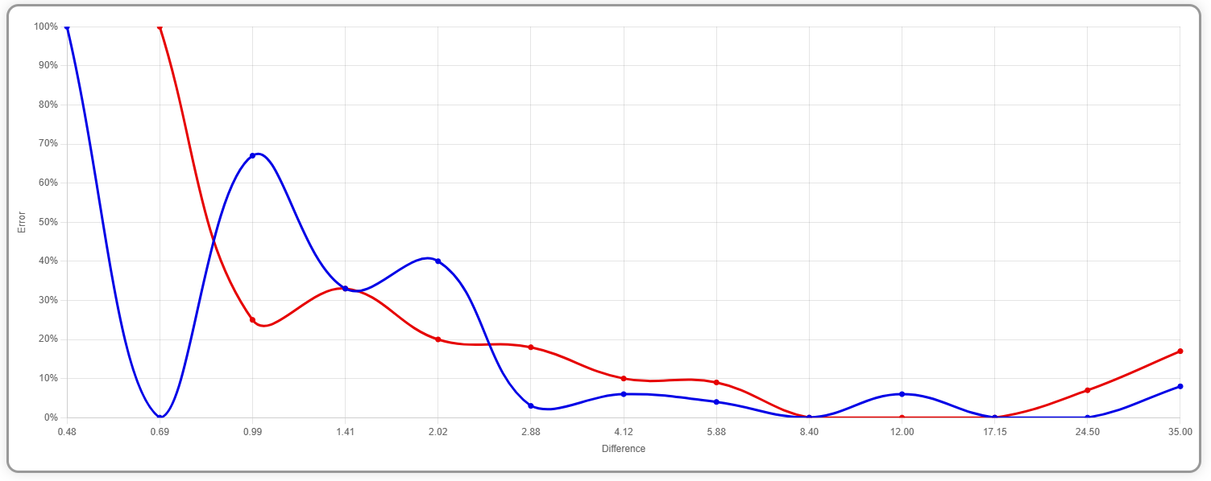
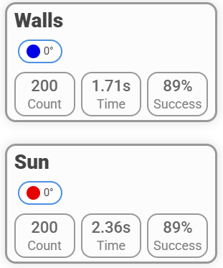
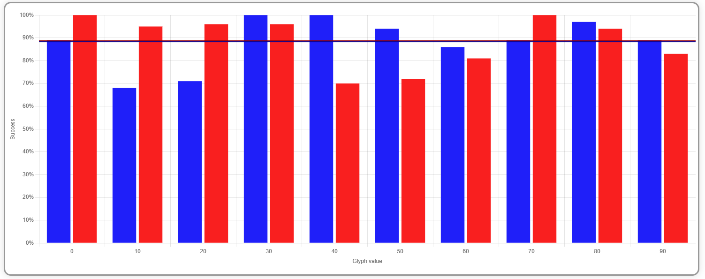
Notes:
Performance/Self Testing
Both graphs were tested on 200 comparisons each.
I was able to resolve comparisons of walls quicker than those of the sun.
This proves that in fact the closing walls graph is easier to read than the more detailed sun graph.
Both graphs had similar success rate of 89%. This can be seen as disappointing for the sun graph, but I can probably see where the main mistake of this design was.
Closing walls:
The error rate kept falling linearly to the distance of the compared graphs.
But still at small distances it was difficult to determine precisely the differences.
This can be attributed to small number of details in the graph.
Second graph shows that I have made most mistakes at lower values of X. This is probably because the area is not fully covered in walls and its difficult to properly compare them.
Sun graph:
Error rate falls quicker than in the closing walls, but it doesn’t get as low.
It show that at smaller distances it was easier to see differences thanks to more details, but it is held back by an error in design.
Second graph shows that I have made most mistakes around the X value of 50.
This shows the error of the design since the movement of the sun slows down rapidly at the maximum of the function and the color of the sky remains still.
At X values around 50 it is extremely difficult to precisely compare two graphs next to each other.
If this issue was fixed, I think the success rate would be considerably higher than that of closing walls graph.

